Slide 1

An Introduction to the All of Us Researcher Program
MAXIMILIAN WEGENER, MPH
Biomedical Informatics Librarian, Cushing/Whitney Medical Library
Yale SCHOOL OF MEDICINE
Biomedical Informatics and Data Science
Yale Harvey Cushing/John Hay Whitney Medical Library

Slide 2
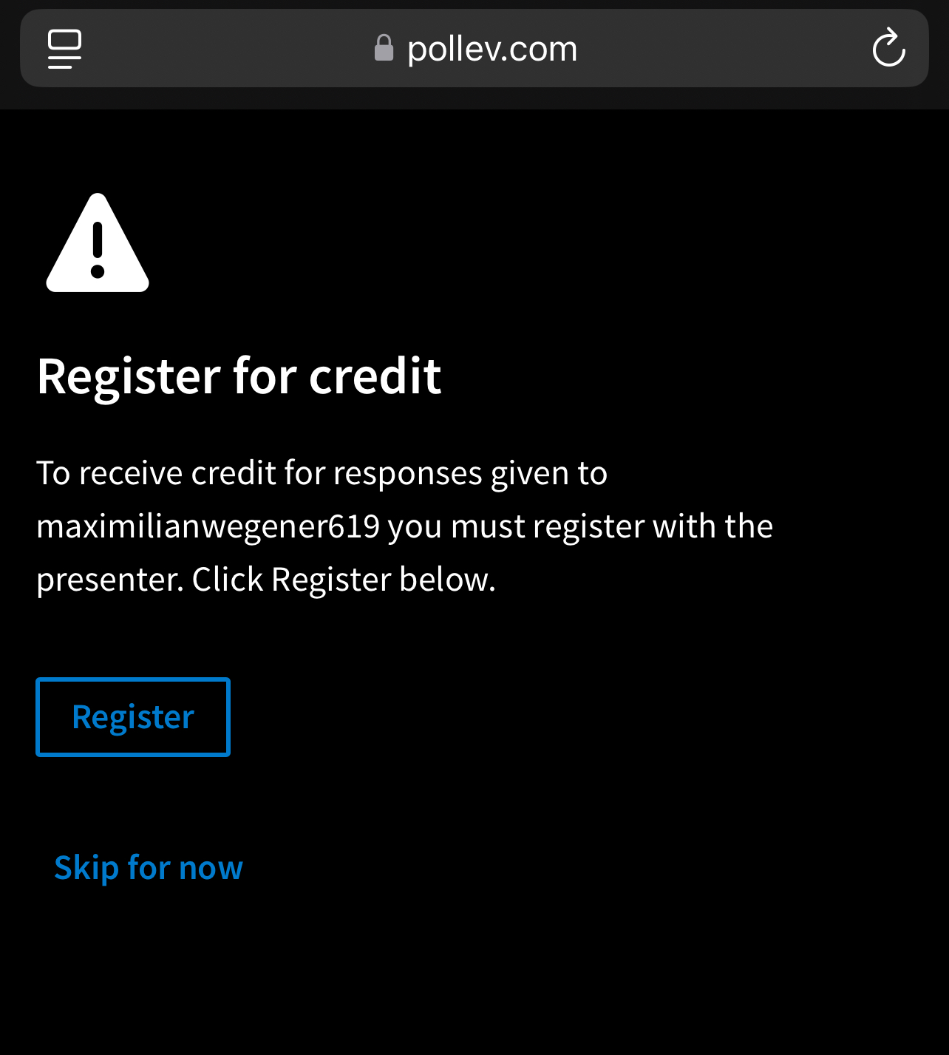
Interactive poll questions

Slide 3
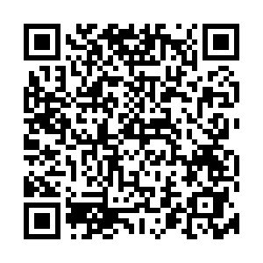
Interactive poll questions

Slide 4
Learning objectives
About All of US
Data sources
Accessing data
Analyzing data
Create an All of Us account and Workspace
Agenda

Slide 5
Explain the All of Us program
Identify key data sources
Understand how data are stored
Create datasets using the cohort builder + dataset builder
Explain some of the analytic methods available for All of Us data
Create a user account and workspace
Learning
Objectives
After this training, you should be able to:

Slide 6
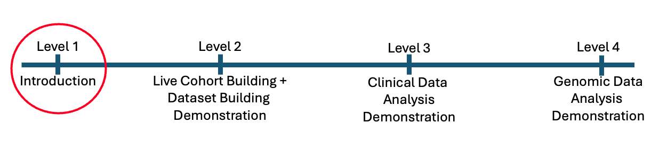
Course Progression
Current Level and Future Directions

Slide 7
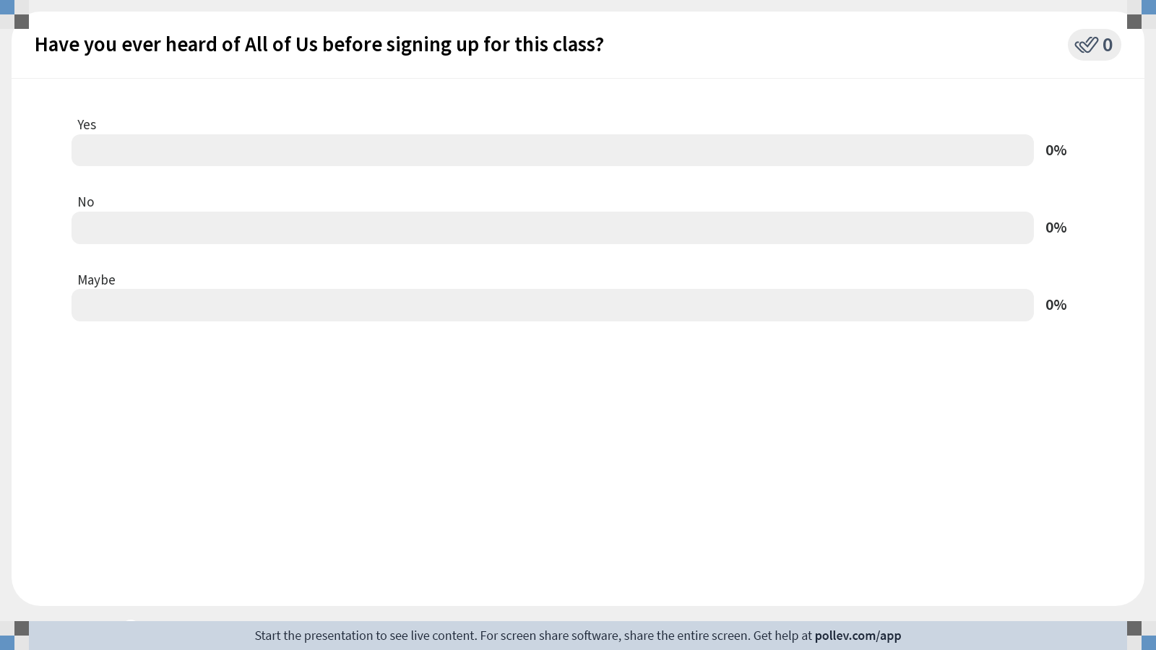
Notes:
Do not modify the notes in this section to avoid tampering with the Poll Everywhere activity. More info at polleverywhere.com/support Have you ever heard of All of Us before signing up for this class?
https://www.polleverywhere.com/multiple_choice_polls/mJz6ARM0ep0clYbIfjwbU?state=opened&flow=Default&onscreen=persist

Slide 8
About the All of Us Research Program
A national initiative by the NIH
Launched in 2018
To gather health data from over 1 million people
Eligible participants join voluntarily
signing up via JoinAllofUs.org
participating health care provider
Background

Slide 9
Enable precision medicine using data on lifestyle, environment, and genetics.
Shift from one-size-fits-all to personalized healthcare.
Boost health research and medical breakthroughs.
Tailor and make healthcare equitable.
Support diverse studies reflecting all populations.
About the All of Us Research Program
Vision and Goals
Notes:
Ensuring everyone has a fair and just opportunity to access quality healthcare, regardless of:
race, ethnicity, socioeconomic status, gender, or geographic location,
addressing underlying social determinants of health and providing care tailored to individual needs

Slide 10
Participant-Centered
Participants view and access their data
Open science
De-identified data available globally
Research opportunities
Health disparities; environmental impacts; disease prevention and treatment
Phenotypic and genotypic data
Scalability & Innovation
Complex analyses; AI and machine learning
About the All of Us Research Program
What makes it unique

Slide 11





Lifestyles, medical history, healthcare access, etc.
Data Sources
Standardized using Observational Medical Outcomes Partnership (OMOP) Common Data Model (CDM)
Surveys
EHR
Wearables
Physical measurements
Genomic
Heart rate, activity, or sleep data from devices like Fitbit
Sources: EHRs, self-reported height and weight, in-person visits.
Whole genome sequencing and genotyping from blood, saliva, & urine
Notes:
OMOP (Observational Medical Outcomes Partnership) Common Data Model (CDM): A standardized data model designed to integrate diverse healthcare data sources into a common format.
Standard Vocabulary: OMOP utilizes a standardized vocabulary system, which includes standard concepts for drugs, conditions, procedures, and other clinical entities to ensure consistency across datasets.
Mapping to Standard Codes: Local codes from different healthcare databases are mapped to OMOP standard codes to enable cross-database analyses.
Applications: Widely used in observational health research, especially for large-scale data analyses, observational studies, and drug safety assessments.
Governance and Collaboration: Managed by OHDSI (Observational Health Data Sciences and Informatics) community, fostering collaboration and consistency in healthcare research.
OMOP codes are crucial because they standardize diverse healthcare data, enabling consistent and comprehensive large-scale analyses, thus advancing research and improving patient outcomes through better data interoperability.

Slide 12
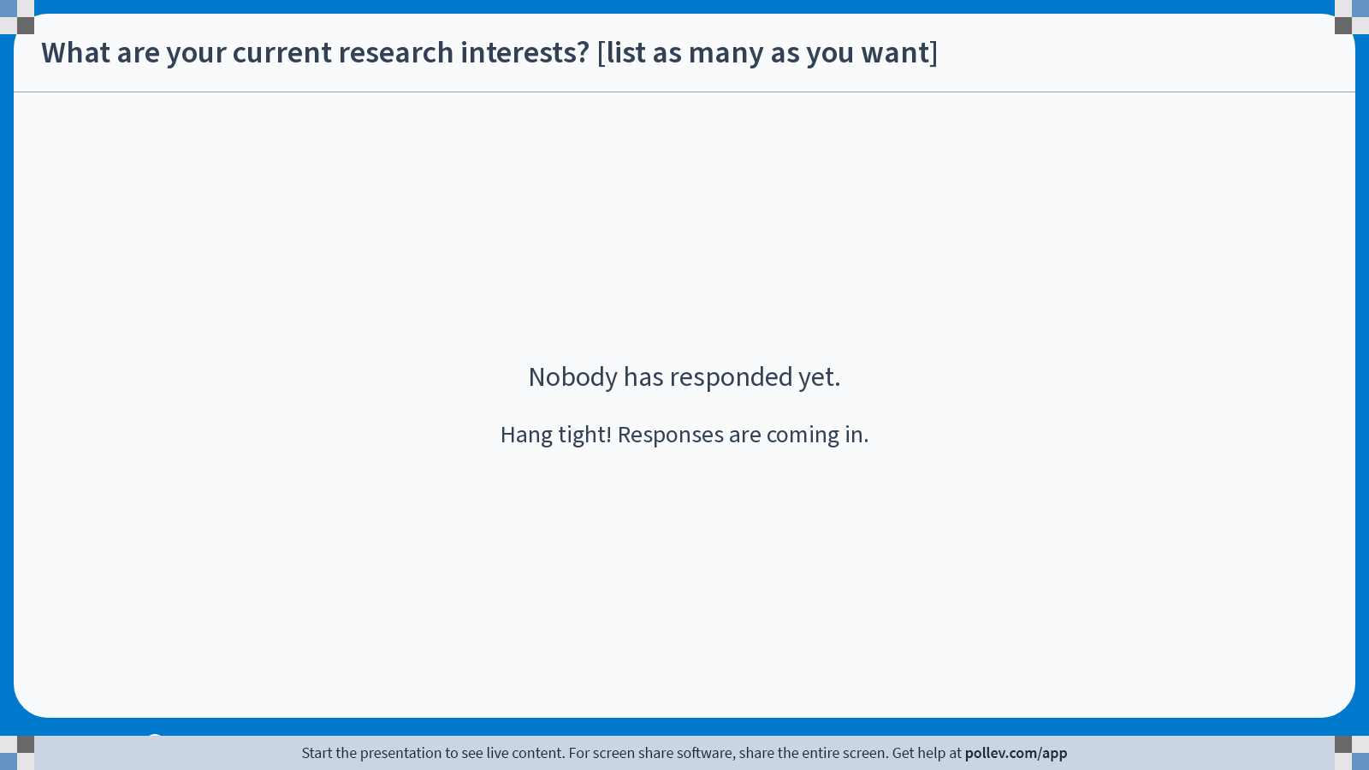
Notes:
Do not modify the notes in this section to avoid tampering with the Poll Everywhere activity. More info at polleverywhere.com/support What are your current research interests? [list as many as you want]
https://www.polleverywhere.com/free_text_polls/GT3jNB9uF45UDsjUwrhbA

Slide 13
Accessing
Data
Organized in a curated data repository (CDR)
De-identified
Cleaned, validated, standardized
Hosted on Google Cloud Platform (GCP)
Scalability, security, and computational power
Data accessed from anywhere
Large-scale data processing and advanced analytics
Background
Notes:
Data Preparation
Curated Data Repository (CDR): Raw data from various sources (EHRs, surveys, etc.) are transformed and standardized into a curated dataset.
Data Storage and Platform
Cloud-based: The Researcher Workbench is built on the Google Cloud Platform (GCP) for security, scalability, and computational power.

Slide 14
Google BigQuery
Database for the CDR
Uses SQL-like queries to retrieve data
R, Python, or SAS
Billed for queries executed and data processed
Large genomic datasets can be costly
$300 credit for Google Cloud usage
The credit will eventually run out
Set up a billing account to continue your work
Navigate here for more information
helpful video here covering billing in more detail
Accessing
Data
Background
Notes:
If you have an NIH grant , your can put the COA (charge of account)

Slide 15
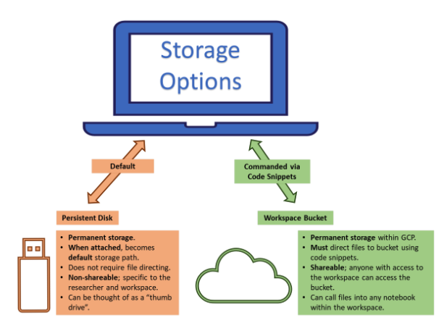
Data Storage
Persistent Disk
Personal storage attached to a virtual machine (VM); not shared and data is saved even if the environment is deleted – best for active work
Workspace Bucket
A shared, permanent storage area for the entire workspace. It is the most cost-effective option for long-term storage and can be accessed from multiple workspace notebooks (using code snippets)
Cloud Analysis Environment
A temporary virtual machine (VM) that provides the computational resources for data analysis. It is separate from the persistent disk and workspace bucket, and it is where you run your code and perform analyses.
Accessing
Data
Background
*for standard
environments
Notes:
Persistent Disk: Think of this as a virtual computer's hard drive. You are billed for the total space you set aside, like buying a 50 GB hard drive, even if you only use 10 GB. It is attached to your virtual machine and is best for active work.
Workspace Bucket: Think of this as cloud storage, like Google Drive. You are only billed for data you store. It's a central, shared location for your team's files and is the most cost-effective option for long-term storage.

Slide 16
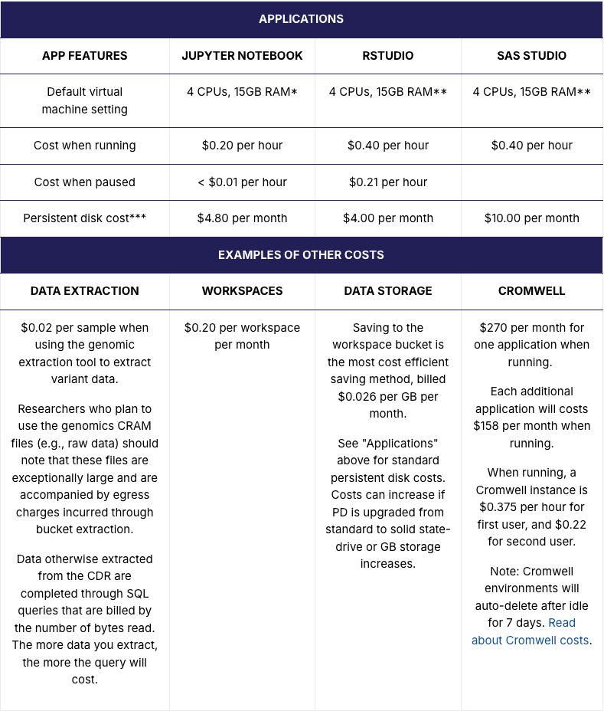
*Jupyter Notebook virtual machine settings can be customized. Customizing default settings will impact costs.
** RStudio and SAS virtual machine settings cannot be customized.
***Persistent disks incur a monthly charge until deleted. You can check for and delete unnecessary persistent disks by visiting your "Cloud Environments" page.
Accessing
Data
Billing Notes
Set up a billing account to continue your work
Helpful video for billing and account setup

Slide 17
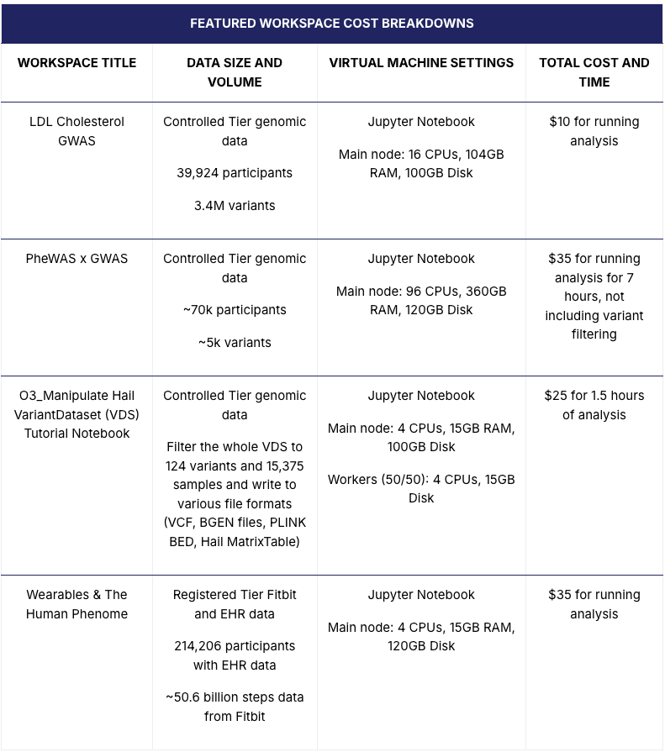
Accessing
Data
Billing Notes
Set up a billing account to continue your work
Helpful video for billing and account setup

Slide 18
Need to get permission from the AoU billing administrator at Yale
who?
Need to set up billing account with credit card on a different google account other than you AoU one
Set up a billing account to continue your work
Create a google account through Yale IT using NETID@yale.edu
Link this billing account with your AoU account
Enabling and Disabling a Google Cloud Platform (GCP) Billing Account
NOTES
Set up a billing on your own

Slide 19
Once you save your data to the workspace bucket:
Delete your environment and persistent disk
Code notebooks are saved in the workspace bucket and will not be deleted
You can always start a new environment to continue your analysis because your code and data in the workspace bucket remain intact
Saving Money!
How to Delete Persistent Disk and Environment

Slide 20
Can use this application to estimate the following:
Upfront costs
Total compute costs
Data storage costs for duration of the project
Total project cost
My AoU Cost Estimator App
NOTES
Beta phase (updates will be made)
Not an official AoU app
Pay attention to the parameters you need
Please provide feedback

Slide 21
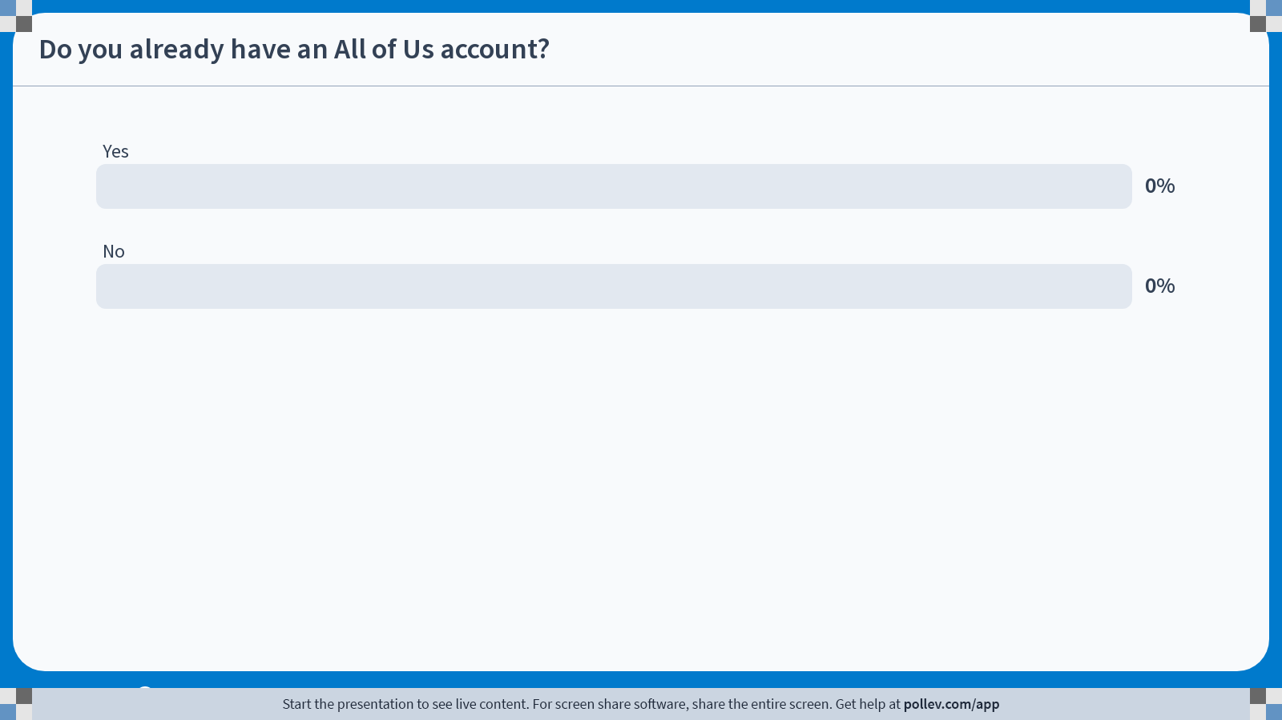
Notes:
Do not modify the notes in this section to avoid tampering with the Poll Everywhere activity. More info at polleverywhere.com/support Do you already have an All of Us account?
https://www.polleverywhere.com/multiple_choice_polls/hLkFcZ58OkTGRVuCWfRtl?state=opened&flow=Default&onscreen=persist

Slide 22
Create a Research Hub account
Navigate to All of Us Research Hub and choose create an account and follow the prompts
Complete data access registration
ID verification; mandatory trainings; code of conduct
Create an all of us workspace
Research Use Statement Questions
All information is publicly available
More than one workspace
Shareable
Where you interact with data
Accessing
Data
Create a workspace

Slide 23
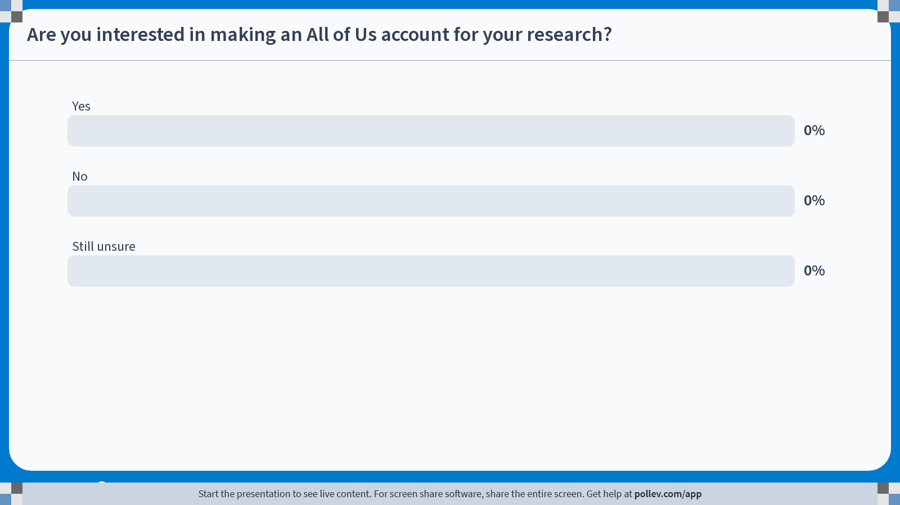
Notes:
Do not modify the notes in this section to avoid tampering with the Poll Everywhere activity. More info at polleverywhere.com/support Are you interested in making an All of Us account for your research?
https://www.polleverywhere.com/multiple_choice_polls/muPCanqbmR6nBkDbOc3cC?state=opened&flow=Default&onscreen=persist

Slide 24
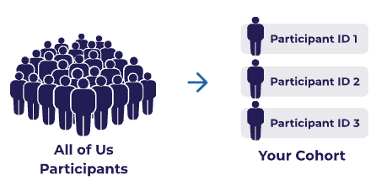
Build your own SQL query within an analysis environment (Jupyter Notebooks, Rstudio, SAS Studio)
Cohort Builder + Dataset Builder
Click and choose
Better for non-SQL users
Less processing
Better for limiting data to what you need
Accessing
Data
Two options

Slide 25
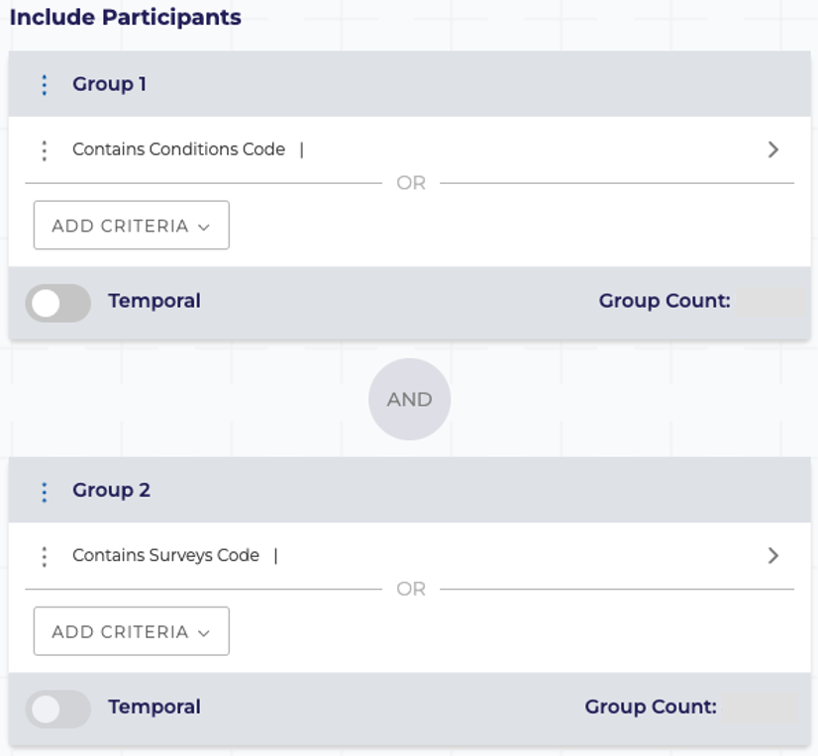
Subset your study population from all participants based on specified criteria using AND/OR operators
Demographics, conditions, measurements, medications, procedures, and surveys
Easily select inclusion and exclusion criteria
Add temporal events
Illness occurs N days before medication was prescribed
Accessing
Data
Cohort builder
Example criteria:
Race -> Asian, Black, White
Sex -> Woman
Age -> 65 or older
Condition - Diagnosed with breast cancer
Medication -Taking tamoxifen
Notes:
Current Age = Age today
Age at consent / age at CDR (curated data repository) = static age at when the person was entered into the study/data were add to CDR -> same age options used for different data query/analysis

Slide 26
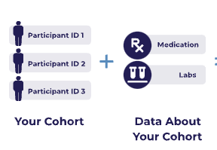
Variables to include in your analysis
Describe information from medical record
Demographics, conditions, prescription, physical measurements, etc.
Organized into concept domains which are the subject areas for each concept
Accessing
Data
Domain | Description
Conditions | Listed by ICD9 or ICD10 or SNOMED standard codes.
Procedures | Listed by ICD9, ICD10, CPT, or SNOMED standard codes.
Drugs or Medications | Listed by ingredient and organized by therapeutic uses.
Measurements | Laboratory tests and vital signs, organized in the LOINC code hierarchy.
Visits | Type of facility where medical care was received (ED, OP, IP).
Surveys | Questions and associated response options for participant-completed surveys.
Physical Measurements | At time of participant enrollment: BP, HR, height, weight, BMI, pregnancy, etc.
Demographics | Age, gender, race, ethnicity, and deceased status.
Concepts

Slide 27
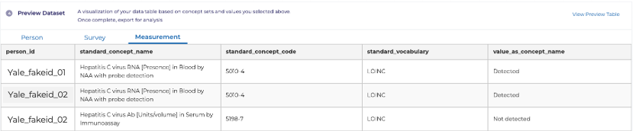
Concept sets are one or more concepts from a particular domain used to create the dataset for your analysis
The values from each concept set becomes its own table under the domain name in the analysis phase
Remember to include the same concepts from your cohort builder
After choosing your concept sets, select which values (columns) you’d like to keep
Measurements
(Domain)
HCV RNA
(Concept)
HBV surface antigen
(Concept)
HIV Ab
(Concept)
HCV, HBV, HIV labs
(“Measurement” Concept Set)
Accessing
Data
Concept sets

Slide 28
Concept Hierarchy for Condition “Atrial fibrillation”
Heart disease
Acute heart disease
Athlete's heart
Cardiac arrhythmia
Cardiac arrest
Supraventricular arrythmia
Atrial fibrillation
Etc.
Etc.
Etc.
General:
a larger pool of patients
Specific:
smaller pool of patients

Slide 29
OMOP CDM is an open-source standard that enables consistent analysis across multiple healthcare databases by standardizing how medical data are organized and coded
OMOP Concepts are standardized units of clinical meaning, each with a unique numeric identifier (concept_id) used for the following domains:
Medications (Drugs) - *RxNorm
Conditions - *SNOMED-CT
Procedures - *SNOMED-CT
Devices - *SNOMED-CT
Observations (including surveys) - *SNOMED-CT
Measurements (Labs) - *LOINC
Forces all variations of the same clinical concept to map to one Standard Concept IDs to use for all analytical work
Making research comparable across institutions by enabling reproducibility and sharing
Accessing
Data
Observational Medical Outcomes Partnership (OMOP) Common Data Model (CDM) Concepts
Explore these standardized vocabularies through Athena
*Denotes where standards concept IDs are derived from
Notes:
RxNorm = Normalized Names for Clinical Drugs
SNOMED-CT = Systematized Nomenclature of Medicine—Clinical Terms
LOINC =Logical Observation Identifiers, Names, and Codes
ATHENA
The purpose of Athena is to serve as a public, searchable resource for the standardized vocabularies utilized within the OMOP Common Data Model (CDM).
Specifically, Athena functions as:
1. A Searchable Database: Athena is a searchable database maintained by the Observational Health Data Sciences and Informatics (OHDSI) community, which manages OMOP.
2. A Vocabulary Explorer: Users can browse and explore the standardized vocabularies used in OMOP through this publicly available website.
3. A Mapping Tool: Its primary function is to help users identify terms and match them to their standard OMOP equivalent.
4. A Domain Navigator: Users can search the platform by typing terms into the search bar or by exploring topics organized according to the OMOP domain.
In essence, Athena supports the fundamental OMOP goal of standardization by providing easy access to the standardized concepts necessary for analysis across different healthcare data sources.

Slide 30
Domains that use SNOMED-CT, often use disparate, non-standard source codes primarily designed for billing
Source codes include:
ICD9/10 (international Classification of Diseases)
CPT4 (Current Procedural Terminology)
Local/Proprietary Codes
Source SNOMED-CT
SNOMED-CT is designated as the standard for OMOP Concept IDs because of its hierarchal structure and clinical granularity
This way a patient coded with ICD-10 in one site maps to the exact same ID as a patient coded with SNOMED CT in another site
*Explore these standardized vocabularies through Athena
Accessing
Data
Observational Medical Outcomes Partnership (OMOP) CDM Concepts
SNOMED-CT and OMOP CDM
Notes:
Sources and Standardization for Condition and Procedure Domains
1. What are the Sources?
For the Condition and Procedure domains, the data originates from a wide variety of Non-Standard and Local Source Vocabularies used by hospitals and health systems.
The most common sources that get mapped into the OMOP Standard Concepts are:
ICD-9-CM (International Classification of Diseases, 9th Revision, Clinical Modification)
ICD-10-CM (International Classification of Diseases, 10th Revision, Clinical Modification/Procedure Coding System)
CPT4 (Current Procedural Terminology, primarily for procedures)
Local/Proprietary Codes (Codes unique to a specific institution or vendor)
Source SNOMED CT (SNOMED codes used by the EHR, which are often already standard)
2. Why is SNOMED CT the Standard?
SNOMED CT (Systematized Nomenclature of Medicine - Clinical Terms) is designated as the primary OMOP Standard Vocabulary for these clinical domains because it offers the best balance of clinical precision, coverage, and structure:
Clinical Granularity: SNOMED CT provides codes for fine-grained clinical details and subtle distinctions that are necessary for research, unlike ICD codes, which are optimized for billing and public health statistics.
Hierarchical Structure: Its poly-hierarchical structure allows researchers to query data efficiently. For instance, a query can easily capture all specific types of Asthma (a broad SNOMED concept) without having to list every single source code (ICD-10 code) individually.
Unified Global Standard: As a globally accepted clinical standard, it acts as a superior "target language" to harmonize data from diverse systems (like the various ICD and CPT versions) into one consistent, research-ready format.
3. The Final Key (The "Why OMOP Concept ID?")
All SNOMED Concepts are assigned a single, stable OMOP Concept ID.
This ID is used for analysis, ensuring that a patient coded with ICD-10 in one site maps to the exact same ID as a patient coded with SNOMED CT in another site.

Slide 31
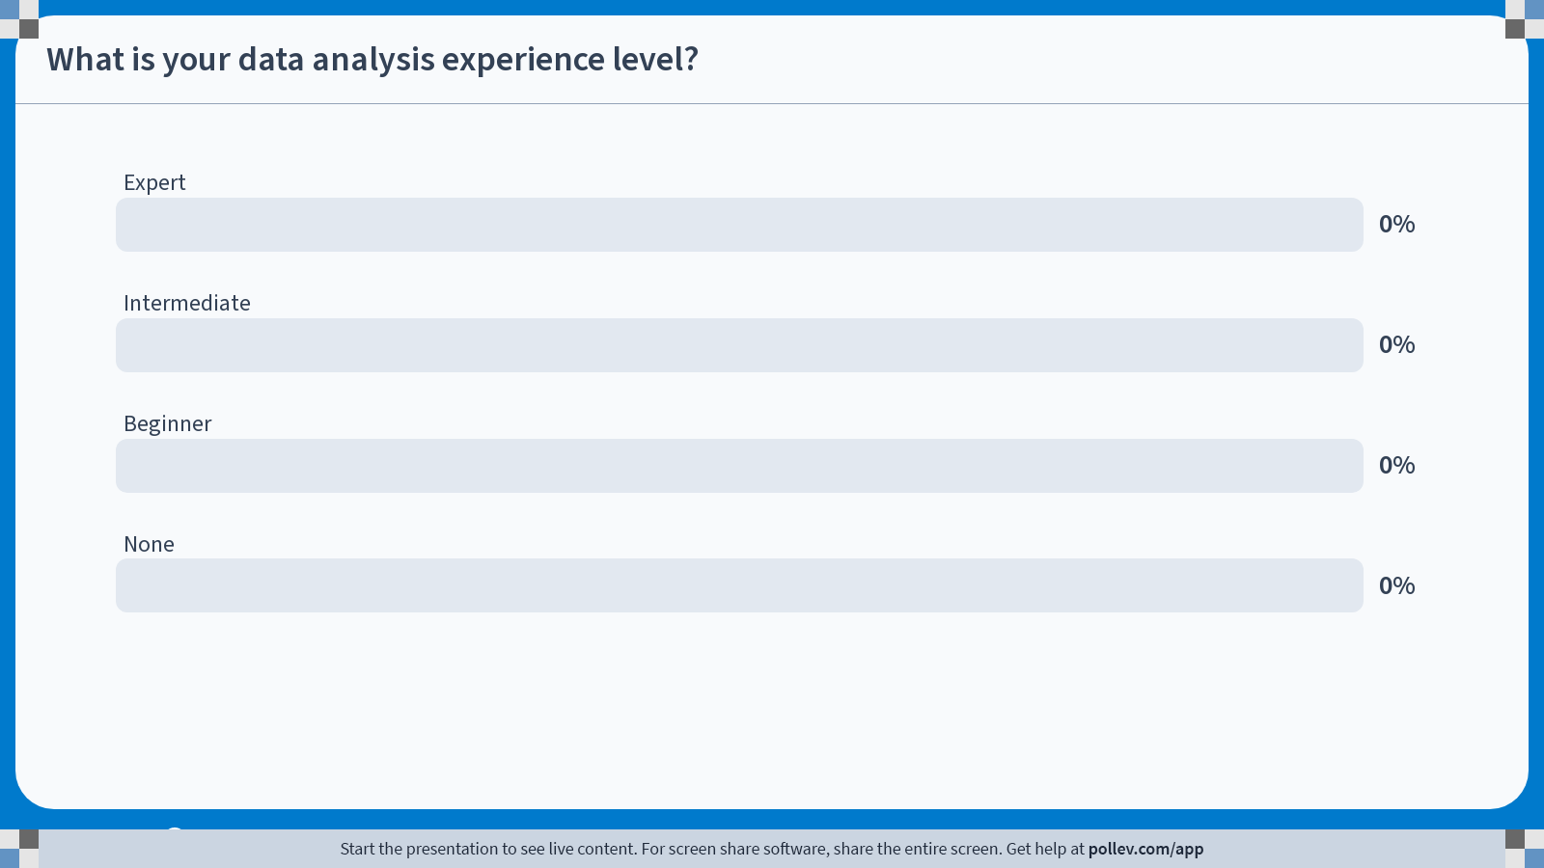
Notes:
Do not modify the notes in this section to avoid tampering with the Poll Everywhere activity. More info at polleverywhere.com/support What is your data analysis experience level?
https://www.polleverywhere.com/multiple_choice_polls/7blKFs199cgFMHWWDvnGQ?state=opened&flow=Default&onscreen=persist

Slide 32
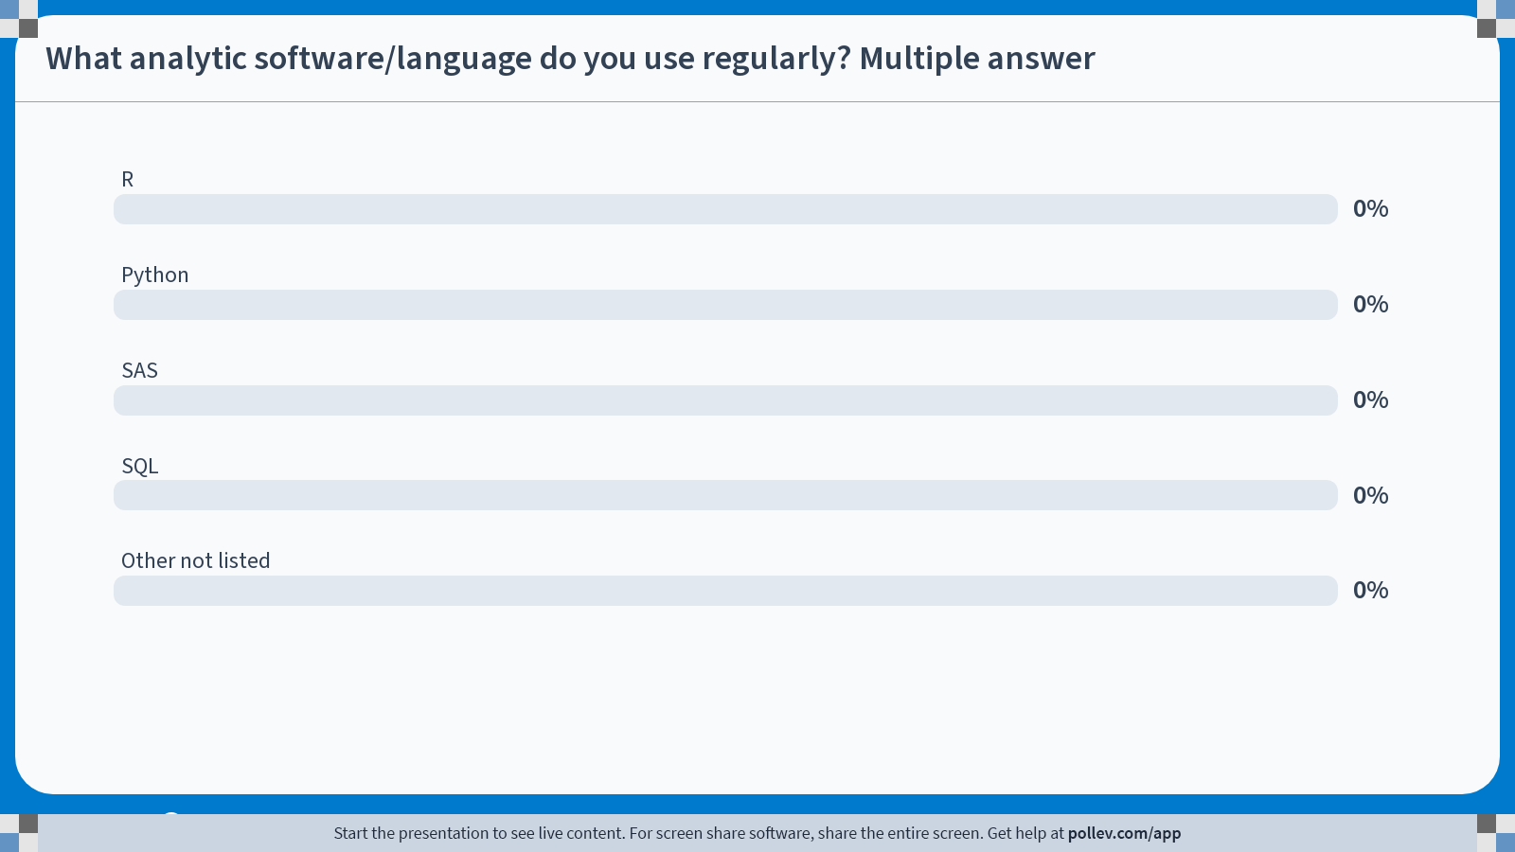
Notes:
Do not modify the notes in this section to avoid tampering with the Poll Everywhere activity. More info at polleverywhere.com/support What analytic software/language do you use regularly? Multiple answer
https://www.polleverywhere.com/multiple_choice_polls/sseGmzIcLaZHDvFp3u63b?state=opened&flow=Default&onscreen=persist

Slide 33
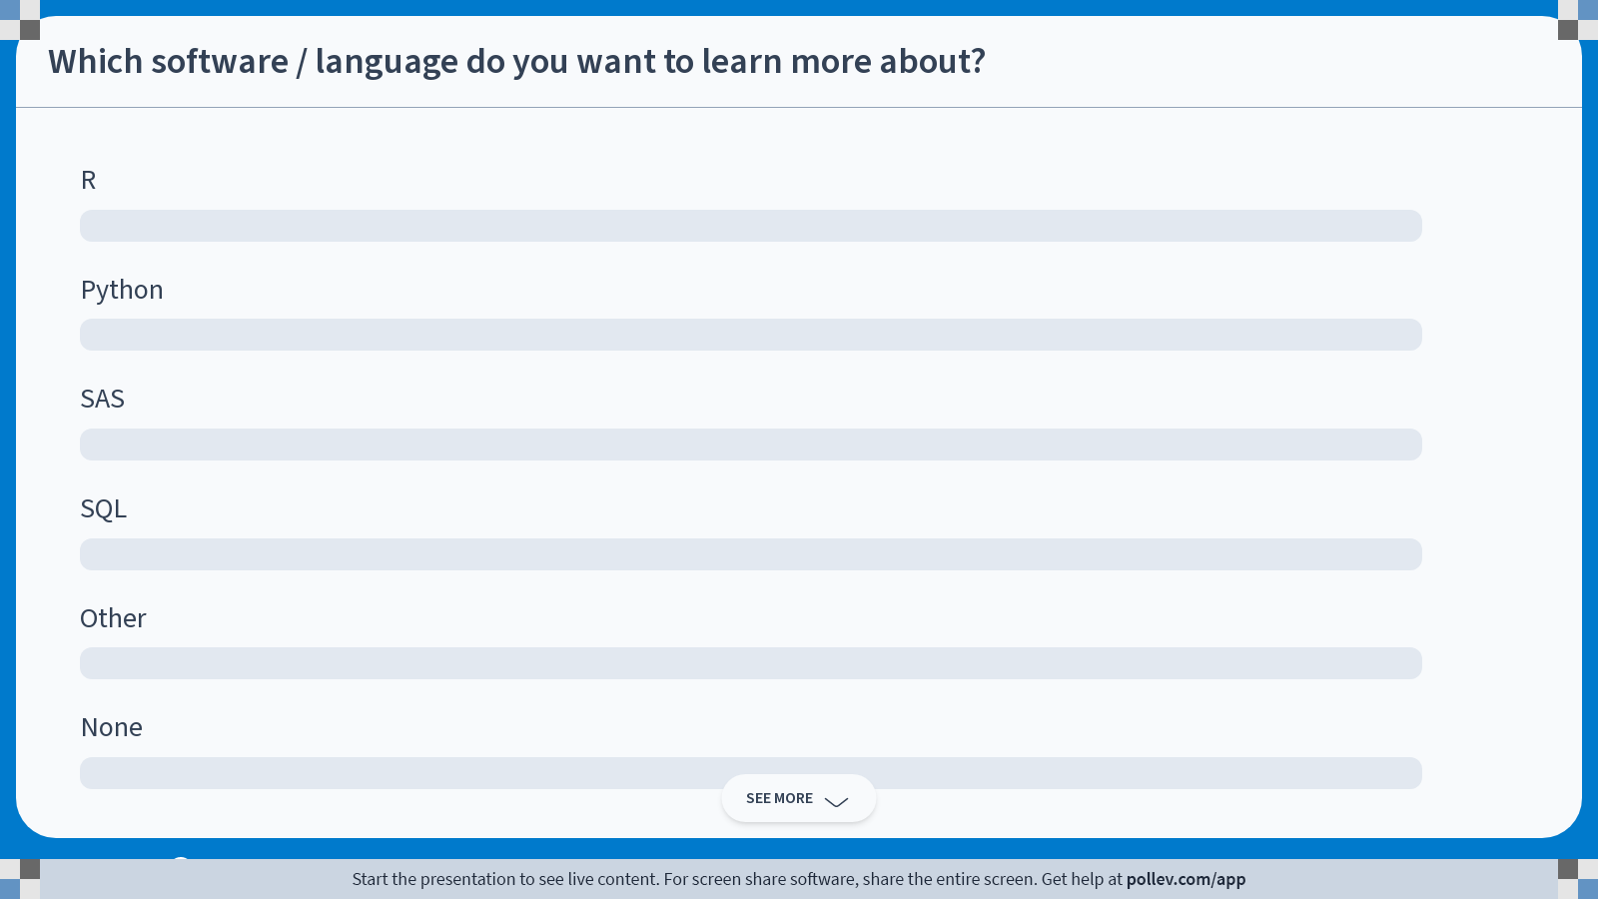
Notes:
Do not modify the notes in this section to avoid tampering with the Poll Everywhere activity. More info at polleverywhere.com/support Which software / language do you want to learn more about?
https://www.polleverywhere.com/ranking_polls/B88bv4vKmHahl1dYU2EVz

Slide 34
Once you select your cohort, concept sets, and concept values, you can create your dataset
Accessing
Data
Dataset

Slide 35
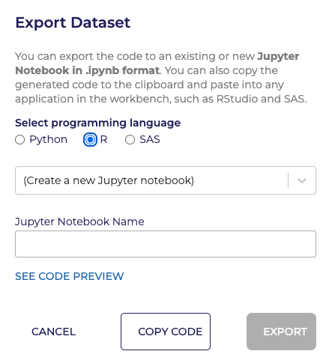
Then choose Analyze, and select the your preferred programming language
Accessing
Data
Analysis

Slide 36
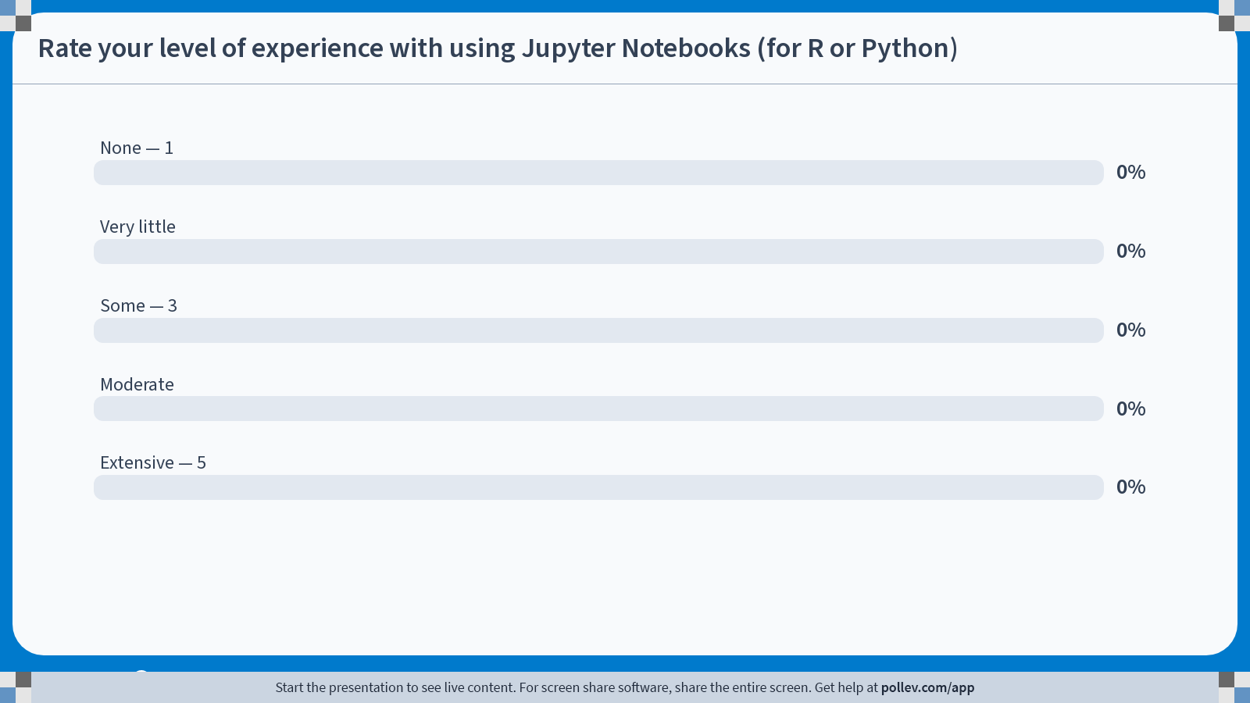
Notes:
Do not modify the notes in this section to avoid tampering with the Poll Everywhere activity. More info at polleverywhere.com/support Rate your level of experience with using Jupyter Notebooks (for R or Python)
https://www.polleverywhere.com/multiple_choice_polls/JuKRPF8zDuKuadmn0eeIL?state=opened&flow=Default&onscreen=persist

Slide 37
Once you choose Analyze, the statistical software environment will be generated
The SQL queries will already be written
One query per concept set domain
Write your own code to clean and manipulate data
Code Snippets to save data to and pull data from Workspace Buckets on Google cloud
Once you do this, you don’t have to rerun the queries every time just import the cleaned data you saved (*Note: can be done in separate notebook)
Accessing
Data
Analysis

Slide 38
All of Us Publications
All of Us YouTube videos
Billing in the researcher workbench
Cohort builder and dataset builder
Using the concept set selector in the workbench
Setting up your Billing Account
Getting started (dictionaries, data types, OMOP, etc.)
Helpful
Resources

Slide 39
Future CWML/BIDS courses aimed to help you work more effectively with All of Us including:
R
Python
SQL
Observational Medical Outcomes Partnership (OMOP) Common Data Model (CDM)
Open to suggestions
Let us know if you are interested in presenting your All of Us work
Check the library training calendar for current course
Sign up for the All of Us live demonstration class here
Future Directions

Slide 40

Questions

Slide 41
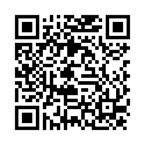
Course
Survey
https://yalesurvey.ca1.qualtrics.com/jfe/form/SV_cZOk3RQmTrQLhYy

